Slide 1
NEXTHIKES IT SOLUTIONS
PROJECT-
BIKE SHARING DEMAND ANALYSIS PROJECT USING EXCEL
BY- SAKSHI JAISWAL

Slide 2
PROJECT OVERVIEW
The bike sharing demand forecasting project aims to analyze bike sharing data to understand how factors such as weather, time, and holidays affect bike usage in urban environments.
By identifying key correlations and trends, the project helps organizations and operators optimize their services and plan for future demand with data driven decision making.
The initiative leverages robust datasets to study user behaviours and patterns in relation to external factors like weather conditions and calender events.

Slide 3
DATA HANDLING AND PREPARATION
DATA SET1
Highlighted the header to improve data set readability and navigation.
Applied filters to column headers to enable quicker sorting and data selection for analysis.
Removed unnecessary columns (season, year, month) to streamline the dataset and focus on relevant features for demand analysis.

Slide 4
DATA SET 2
Highlighted the header to improve data set readability and navigation.
Applied filters to column headers to enable quicker sorting and data selection for analysis.
Identified missing values in the ‘atemp’ column and addressed them by applying the AVERAGE formula to fill gaps, ensuring data consistency for further analysis.

Slide 5
MERGED DATA SET 1 & 2
Merged data set 1 & 2 using the common ‘ instant’ column, applying VLOOKUP function to efficiently combine related records.
Created a new ‘Day’ column by using the TEXT formula to extract and display day information for each entry.
Highlighted header for better data visualization and accessibility across the merged dataset.
Applied filters to column headers to enable quicker sorting and data selection for analysis.

Slide 6
DATA SET 3
Reviewed rows 611 to 619, found demand values below 1000, and restored these entries to their correct values to maintain data accuracy.
Applied the TEXT formula to extract the day from the date column for further analysis.
Highlighted header for better data visualization and accessibility across the merged dataset.
Applied filters to column headers to enable quicker sorting and data selection for analysis.

Slide 7
FINAL MERGED DATA SET
Merged the last merged data set with new data set 3, highlighted headers, and applied filters to improved navigation and data management.
Calculated temperature percentiles (0.25 and 0.75) to set thresholds for weather based segmentation.
Created a ‘Type of Temperature’ column- classified temperature as ‘cold’ (less than 0.16), ‘moderate’ (0.16 to 0.24), and ‘hot’ (greater than 0.24) for actionable categorization.
Created a ‘Type of Humidity’ column- classified humidity as ‘high’ >0.7, ‘moderate’ – 0.44-0.7, and ‘low’ <0.44
Created a ‘Weather Condition’ column- classified as ‘clear’=1, ‘mist/cloudy’=2, ‘light rain’=3, ‘heavy rain’=4

Slide 8
Applied summary formulas ( AVERAGE, MAX, MIN) to the Casual, Registered, and Total count columns to extract key statistics on bike rental behaviour.
Used SUM(SUMIFS) formulas to calculate total bike rentals and their breakdown by ‘casual’ and ‘registered’ for weekends and weekdays, supporting targeted analysis of user segments and trends.

Slide 9
Developed dashboard pivot charts on sheet2 in final merged data set for-
Total bike rentals and their breakdown by casual and registered for weekends and weekdays
Hourly bike rental patterns
Relationship between temperature type and total rentals.

Slide 10
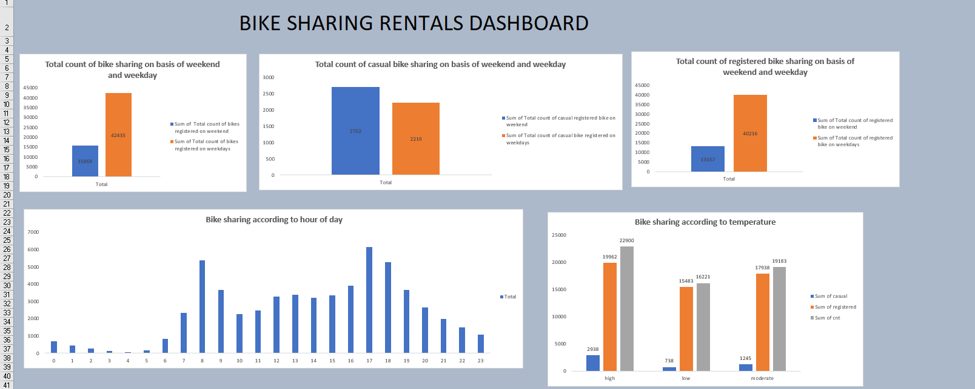
DATA VISUALIZATION

Slide 11
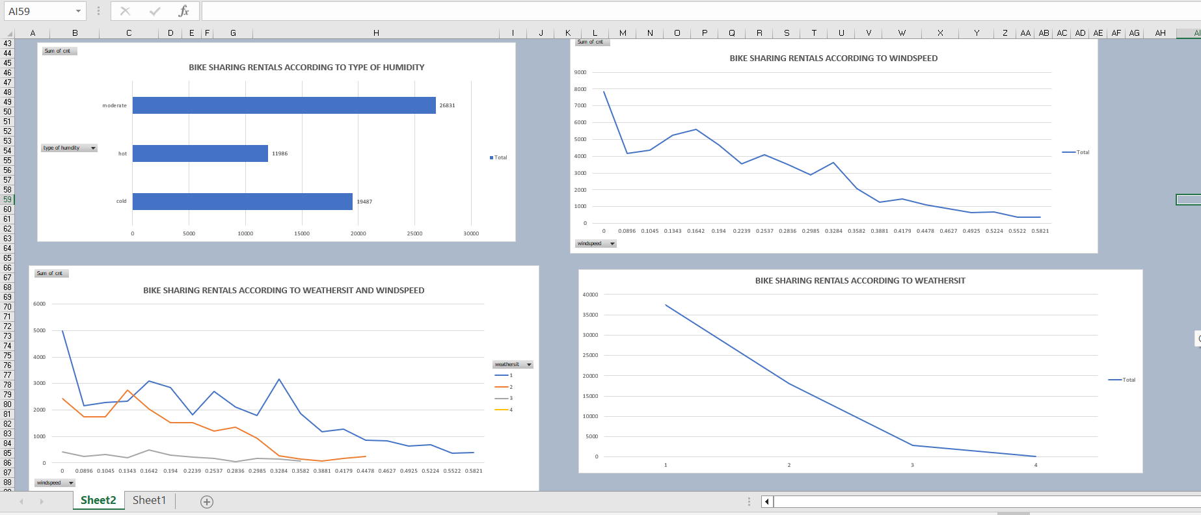

Slide 12
INSIGHTS
WEEKEND vs. WEEKDAY DEMAND-
The total count of bike sharing is significantly higher on weekdays compared to weekends.
Casual users participate more on weekends and registered users on weekday, but registered users still form the majority in total rentals.
CASUAL vs. REGISTERED USERS-
Casual bike sharing remains relatively balanced across weekend and weekday, with a slight increase on weekends. This reflects non- subscribers taking advantage of free time and better weather.

Slide 13
2. Registered users, however, contribute the largest segment of rentals, especially on weekday, confirming their regular engagement with the service.
HOURLY RENTAL PATTERNS-
Bike sharing demand peaks sharply in the morning hours (around 8 AM) and later in the evening (around 5-6 PM), aligning with typical commute times.
Lower demand is observed during late night and early morning, suggesting fewer users during non working hours.

Slide 14
IMPACT OF TEMPERATURE-
Rental counts increase with higher temperature categories, especially in the ‘hot’ temperature segment. This holds true for total rentals and for both casual and registered users.
Moderate temperature also sustain strong bike usage, likely due to comfortable riding conditions, while cold temperatures correspond to a marked drop in rentals.

Slide 15
IMPACT OF HUMIDITY
Rentals are higher during moderate humid conditions
Low and high humidity see fewer rentals with similar counts.
IMPACT OF WINDSPEED
Rentals decrease with increasing windspeed.
Most rides are observed at lower windspeed ranges.

Slide 16
WEATHER CONDITION
Rentals sharply drop with worsening weather conditions.
Clear or fair weather yields highest rentals
COMBINED IMPACT
Both high windspeed and adverse weather reduce rentals in parallel.

Slide 17
THANK YOU

